Slide 1

ONLINE OTR VERIFICATION
SYSTEM FOR GNDEC
1

Slide 2

PRESENTATION FLOW
1
INTRODUCTION
PROBLEM STATEMENT
1
2
3
PROBLEM SOLUTION
4
WORK FLOW OF SYSTEM
5
IMPACTS AND BENIFITS
6
FUTURE SCOPE
2

Slide 3
INTRODUCTION
•The National Scholarship Portal (NSP) provides a centralized platform for students to apply for various scholarships.
•The online One-Time Registration (OTR) verification system for colleges aims to streamline the scholarship application and verification process, reducing manual intervention and improving efficiency.
•The proposed system will enable students to register, check their scholarship status, and receive automated notifications upon successful verification and submission.
3

Slide 4
Objectives
•Design and implementation of a web based platform for scholarship form submission and verification
•Facilitate the College scholarship department to check the status of students scholarship application
•Auto generated and send confirmationmessagesto the usersemail upon successful verification and submission.
4

Slide 5

PROBLEM STATEMENT !
The OTR (One-Time Registration) process under the PMS government scholarship scheme is a new requirement, but there is currently no automated system in place to manage student OTR submissions or verify them.
No automated system exists to store or verify student OTR submissions.
No centralized Scholarship Management System in the college.
Notices and updates are shared only through WhatsApp.
Students and authorities face difficulty tracking submission status.
5

Slide 6
PROBLEM SOLUTION
Develop an automated OTR verification system .
Create a centralized portal for managing student scholarship records and status.
Enable real-time notifications for students on verification and submission updates.
Ensure a more transparent, organized, and efficient scholarship process.
6

Slide 7
Impacts And Benifits
Simplified OTR Submission
- Students can upload OTR card with OTR number.
- Our System will verify and send e-mail to student.
- Eliminates manual paperwork and back-and-forth emails.
2. Data Integrity & Accessibility
- Scholarship management can access student details.
7

Slide 8
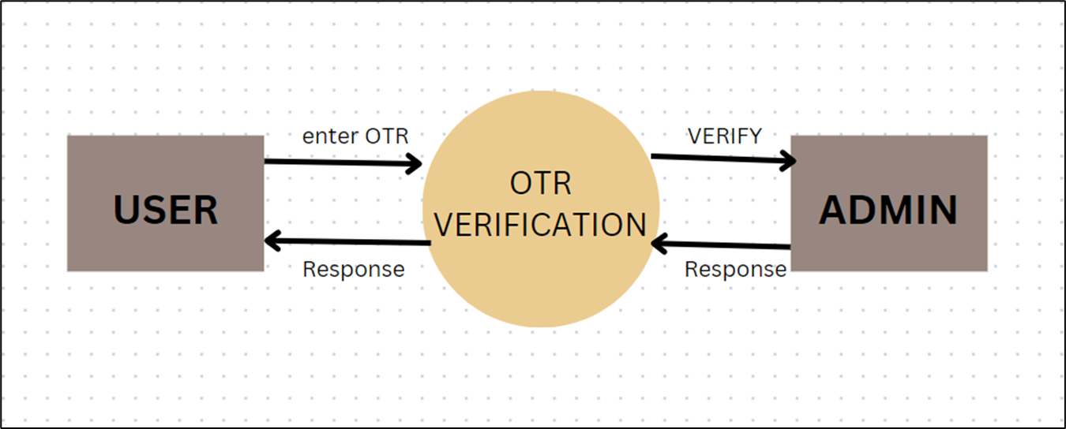
WORK FLOW OF SYSTEM
8

Slide 9
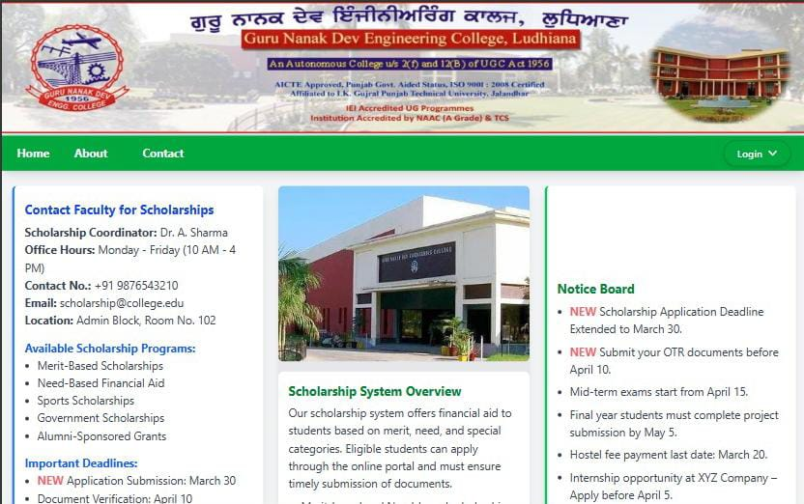
HOME PAGE
Login Student or Faculty
9

Slide 10
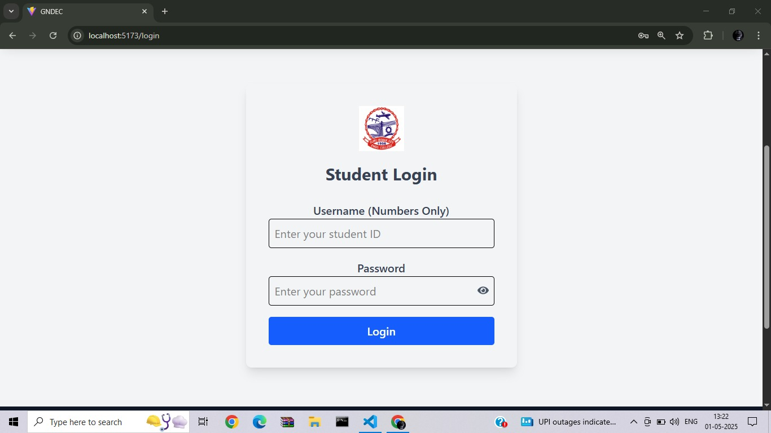
If User will click on Student login
10

Slide 11
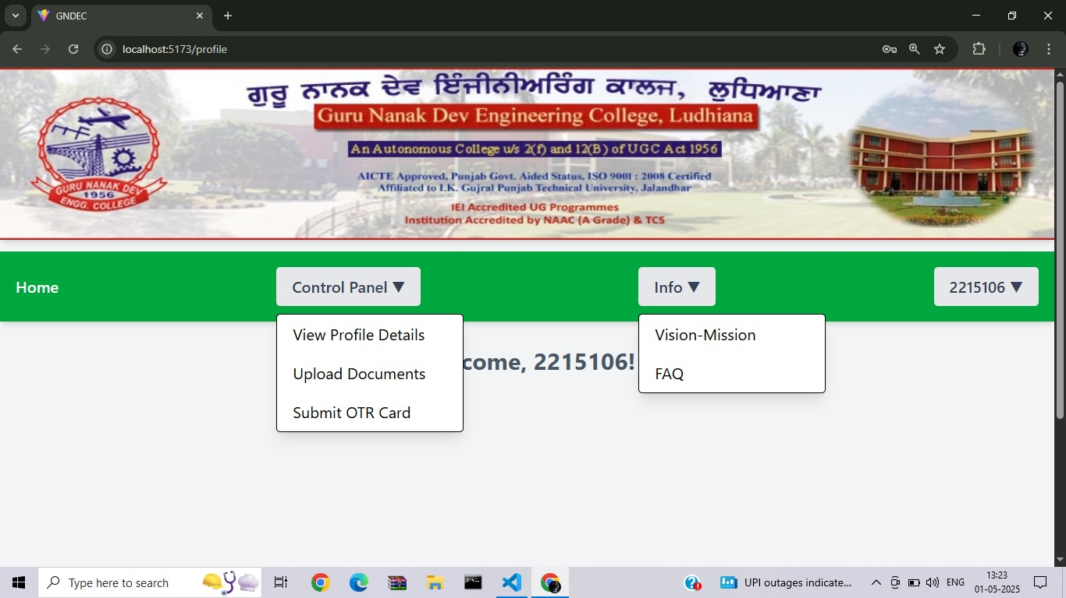
Then user direct to student dashboard
11

Slide 12
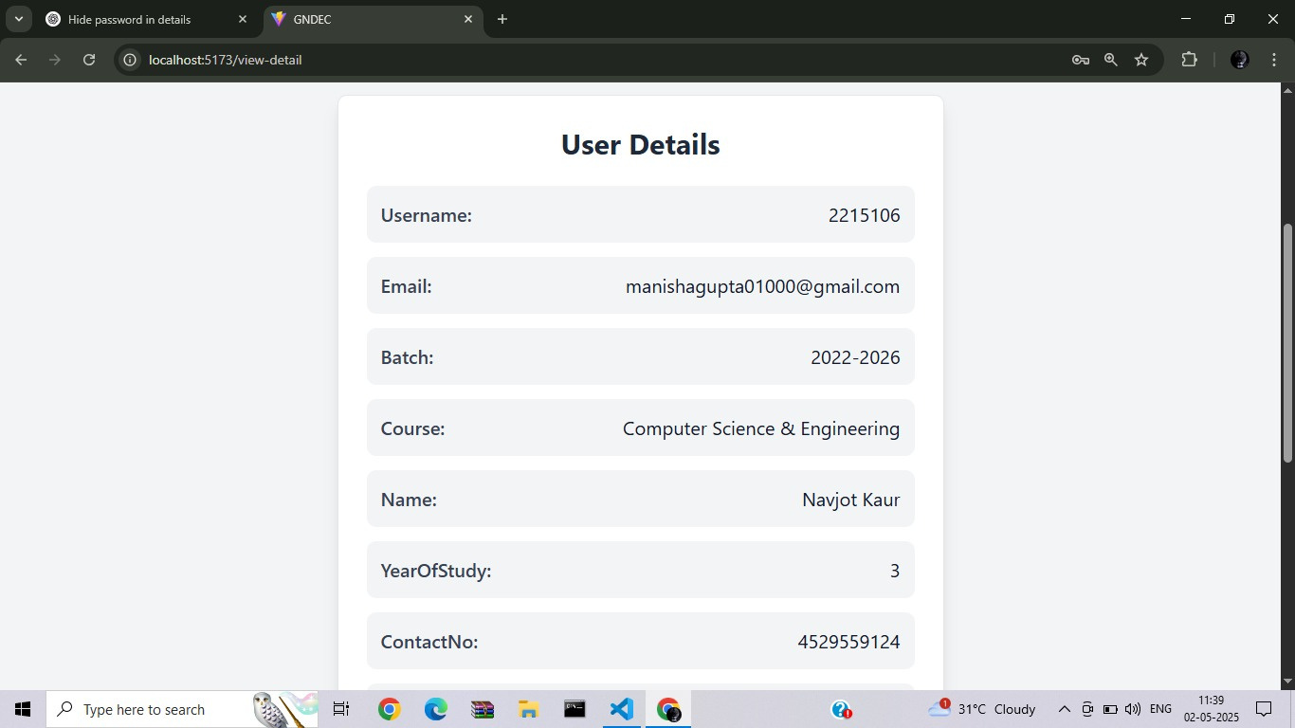
When user click on view details
12

Slide 13
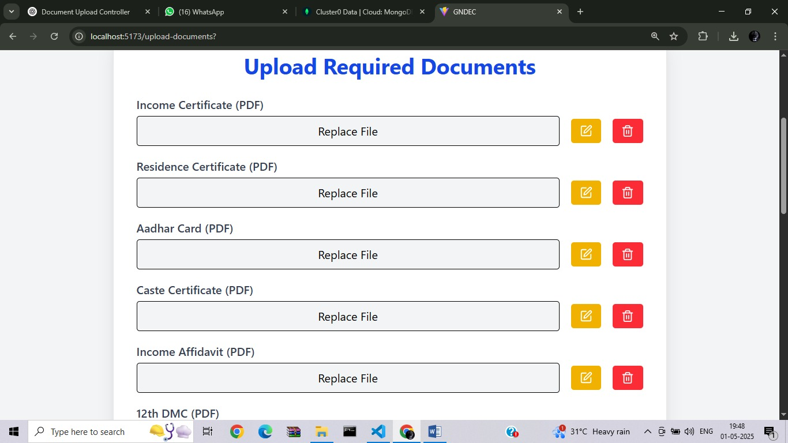
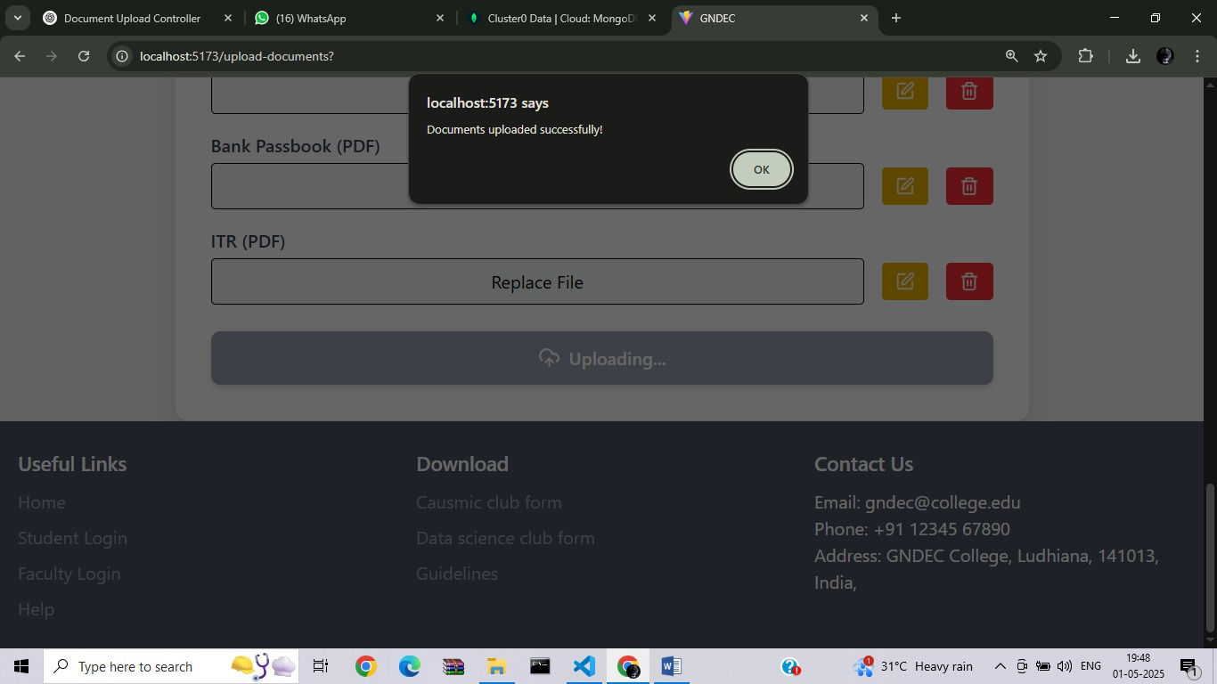
When user will click on upload documents
13

Slide 14
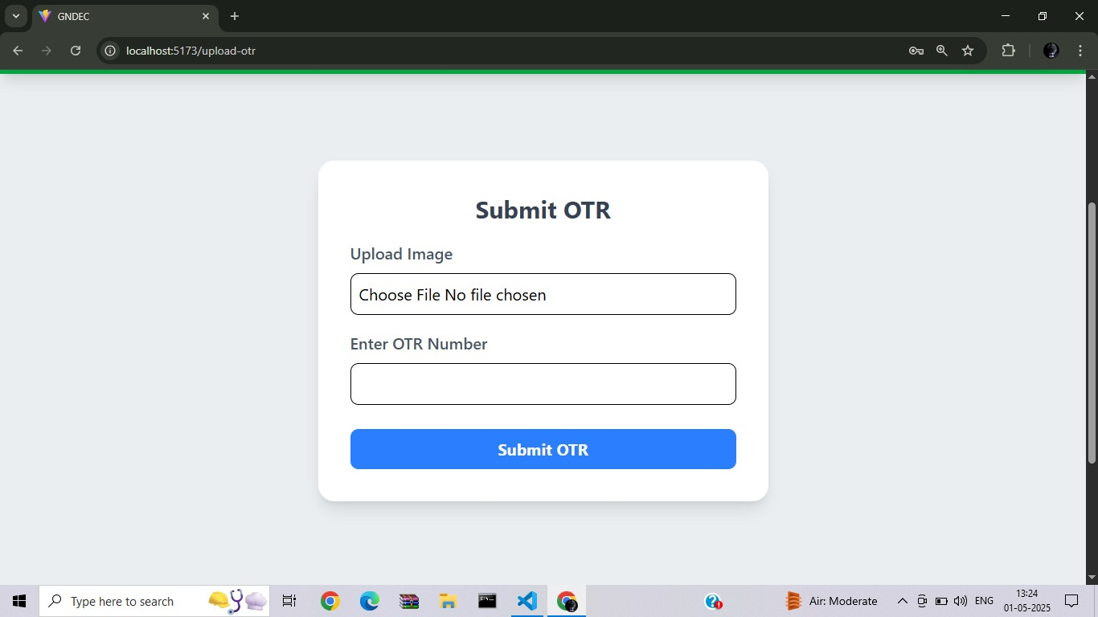
when user click on submit otr
14

Slide 15
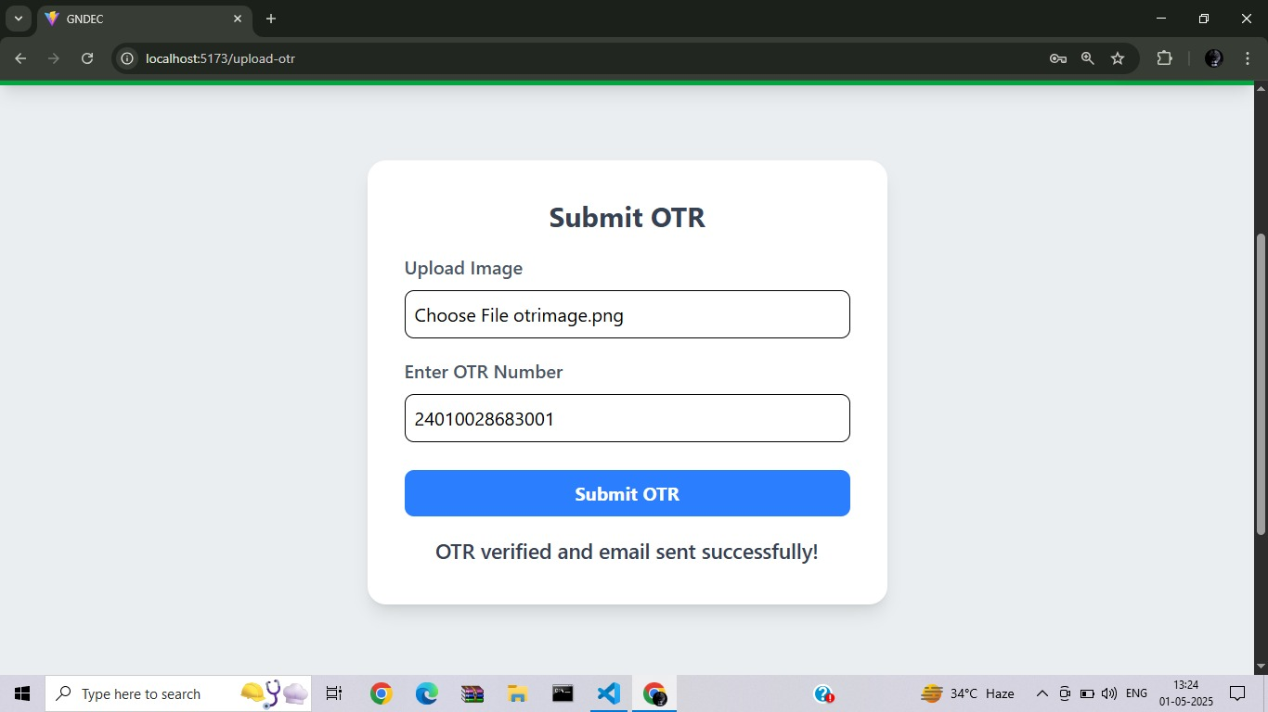
When user enter his OTR number and upload OTR card
15

Slide 16
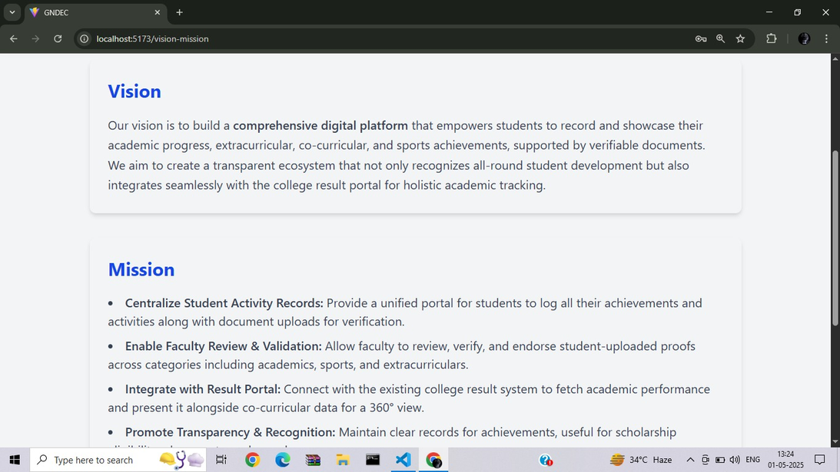
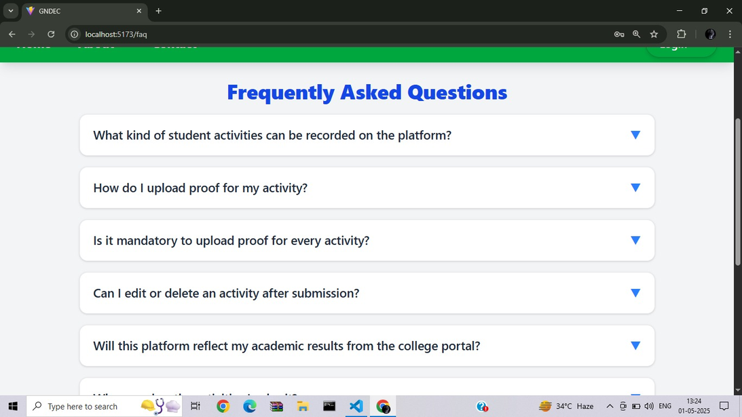
When student click on vision mission and OBE
Vision and missions
OBE
16

Slide 17
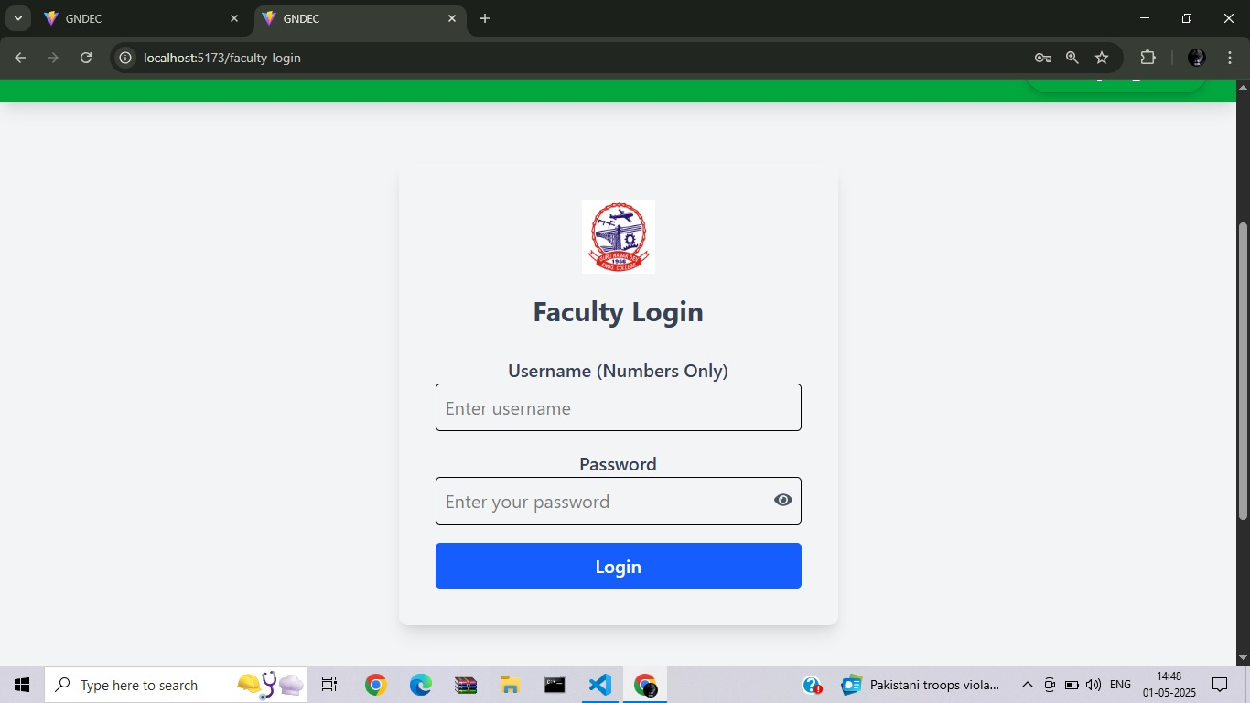
When user choose faculty from home page login
17

Slide 18
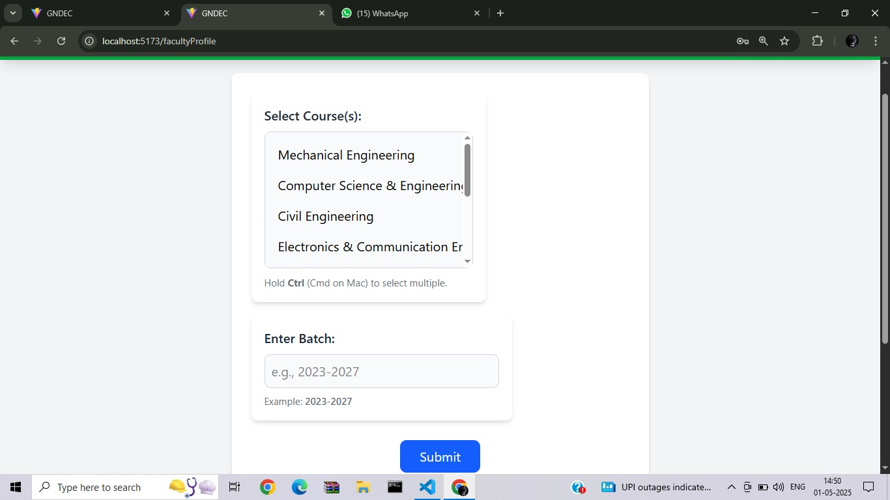
Faculty can view details of student status
18

Slide 19
FUTURE SCOPE
Update Announcements
Admin can update latest notices regarding scholarship.
2. Student details filtration
Faculty can see student details on the basis of different filters on student’s details like documents , Submission status i.e By Student’s Batch, Year of study, Branch and even all Students data in one frame.
3. Student Query panel
If student face any kind of issue which is not mention in FAQs they can send directly email to scholarship management authority.
19

Slide 20
THANK YOU!
20

